Slide 1

Women in Software Engineering
The Ugly, The Bad, & The Good
By
Rabeb Othmani

Slide 2
The Speaker!
Engineer
Woman Who Code
Woman-In-Tech

Slide 3
The Talk!
Software Engineering
Women in Software Engineering:
Why Does It Matter?
The Ugly Truth.
The Bad Things.
The Good Bits.
What I’ve Learned by Being a Woman in Software Engineering.

Slide 4
Software Engineering
“Software engineering is the study and application of engineering to the design, development and maintenance of software.”-Wikipedia
Software systems should be:
On time
On budget
With acceptable performance
With correct operation
Notes:
Software engineering is about the practicalities while computer science is about the theories and fundamentals. Software engineering includes tools, methodologies(agile, code and fix, prototyping etc) and techniques(formal procedures using well defined notations).

Slide 5
Computing fundamentals
Algorithms & data structures
Computer architecture
Software product engineering
Requirements
Operating systems
Programming languages
Mathematical foundations
Design
Code
Tests
Software management
Project process management
Risk management
Software domains
Artificial Intelligence
Quality management
Dev process management
Database systems
Human-Computer interaction
Real time systems

Slide 6
Women in Software Engineering Why does it matter?
The economies of all developed nations are dependent on software.
More and more systems are software controlled.
It’s one of few careers that offers a variety of opportunities in both salary and flexibility
Notes:
Mobile internet revolution: networks, broadband,etc

Slide 7
Women in Software Engineering The ugly truth
Women hold just 15% to 17% of the technical roles at major tech companies such as Facebook, LinkedIn and Google.
According to US Bureau of Labor Statistics, these professions attract more women in percentage than software engineering ( 20.2%)
Bailiffs, correctional officers, jailers (26.9%)
Chief executives (25.0%)
Database administrators (35.3%)
Biological scientists (45.1%)
Chemists and materials scientists (30.0%)
Technical writers (50.4%)
Notes:
Study made by linkedin using linkedin data

Slide 8
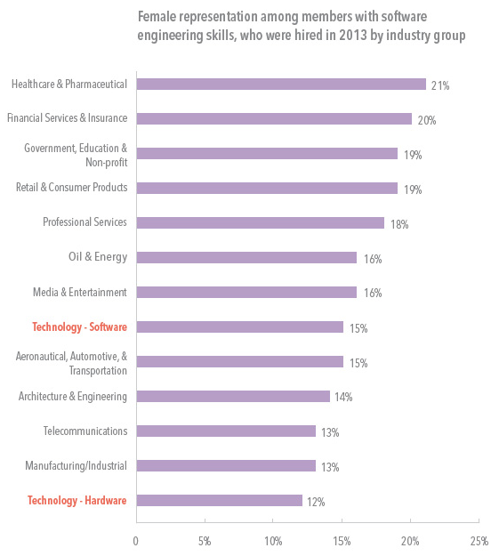
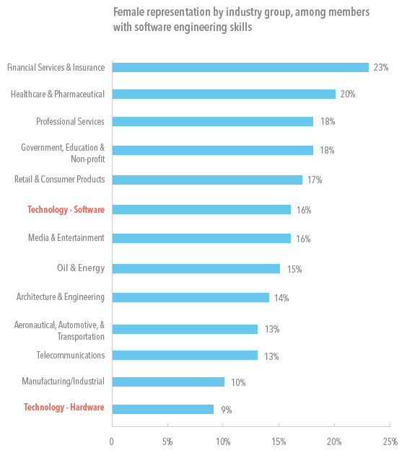
Women in Software Engineering Stats

Slide 9
Women in Software Engineering The Bad things
Bropropriating
Sexism
Manterrupting
Hearing problems
Career Progression
Notes:
Manterrupting: Unnecessary interruption of a woman by a man.
Bropropriating: Taking a woman’s idea and taking credit for it.

Slide 10
Women in Software Engineering The Good bits
Us: women in engineering discussing women in engineering.
Organizations and initiatives working to shift the cultural perception of women in engineering: Girl Geek Dinners, Women Who Code, Talent2030, Women In Technology…
It is a job that only requires a BRAIN.
It is fun.
It is challenging.
You will never be bored: everyday learning, creativity, problem solving…
WE.CAN.DO.IT ( remember Ada Lovelace, Grace Hopper, Anita Borg, Marissa Mayer…)
Notes:
We defined the problem, we know there is a problem and we are working on it

Slide 11
What I’ve Learned by Being a Woman in Software Engineering
Be proud of who you are.
Speak up
Don’t be intimidated
Work hard, challenge yourself
Learn new things, take ownership
Master the technology
Networking

Slide 12

Keep in Touch
http://rabebothmani.com
Othmani.rabeb@gmail.com
@Rabeb_Othmani

